Slide 1


Slide 2
Weekly Updates
Please provide a quick update on either:
Something you did/saw this week that you thought was interesting
What you’re looking forward to about this week’s workshop
(Reminder - please have your cameras on if possible)

Slide 3
Workshop 4
Featurization & Baseline Modeling

Slide 4

Recap

Slide 5
Sessions Overview
Workshop 1 – Project Introduction & Setup
Workshop 2 – Genomic Data (A2 Assignment)
Workshop 3 – Data Analysis & Visualization (A3 Assignment)
Workshop 4 – Featurization & Baseline Modeling (A4 Assignment)
Workshop 5 – Model Training Approaches (Final Assignment Set)
Workshop 6 – Model Tuning
Workshop 7 – Performance Evaluation (Final Assignment Code/Testing Due)
Workshop 8 – Results Presentation & Wrap up (Final Presentation Due)

Slide 6
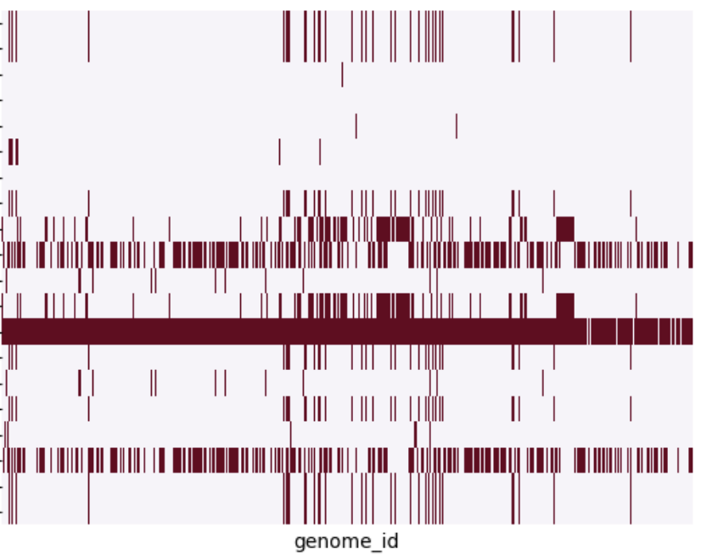
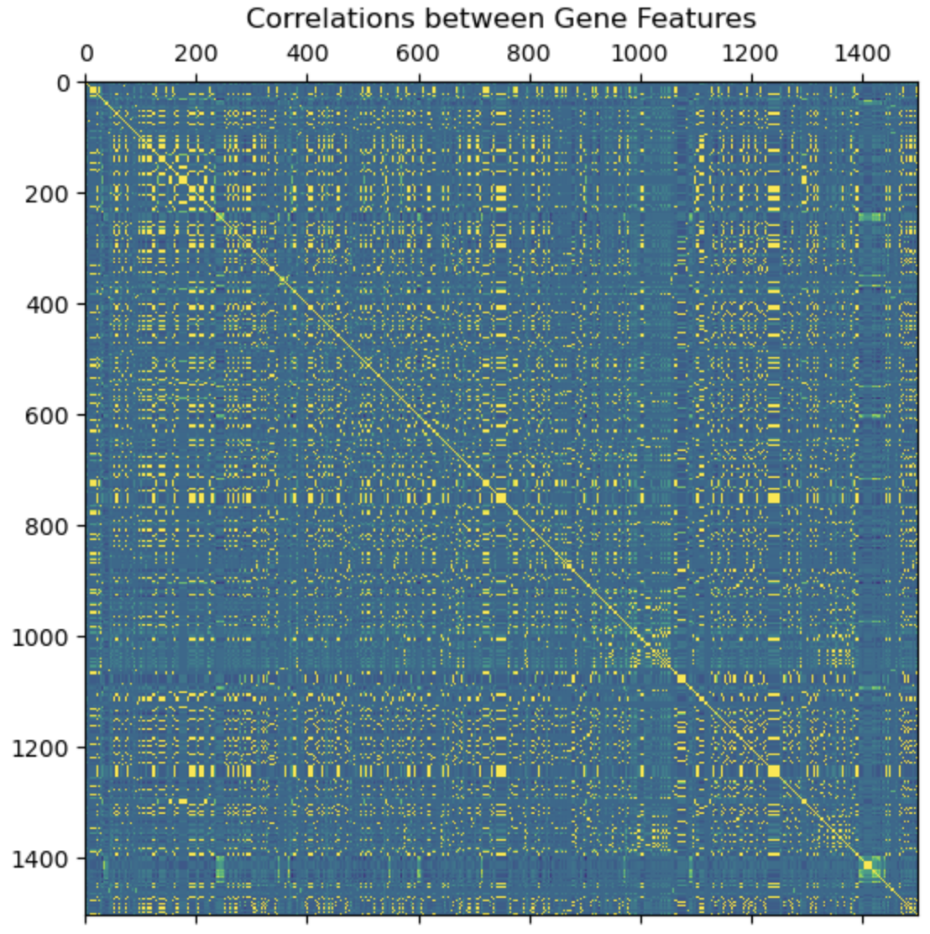
Exploratory Data Analysis
Gene presence/absence
genes
What did we achieve last week?
Took a look through our datasets, finding key information
Processed our targets (AMR) into clean binary S vs R
Identified a few suspicious E coli genomes
Reviewed gene presence/absence across samples
Started reviewing the nucleotide sequences and identified some mutations
Assignment (Optional):
Identified highly correlated genes

Slide 7
The Data Science Process
Understand the Problem
Gather Data
Explore & Analyze Data
Repeat as needed:
Data Science is an iterative process
Featurize Data
Model Building
Evaluate and Compare
Present Results

Slide 8
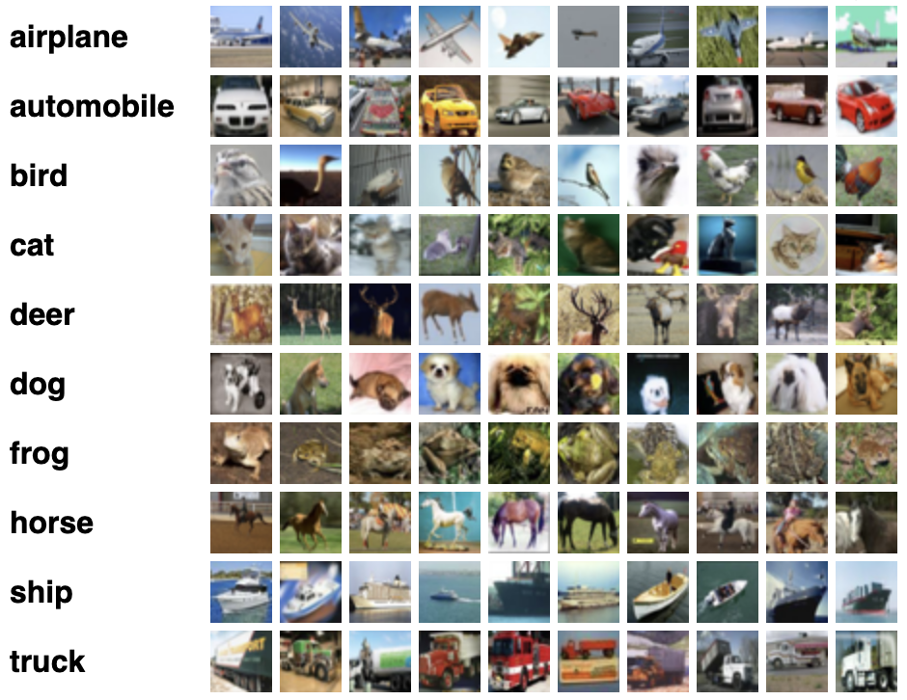
What is Featurization?
Gene Alignment to Sequence Input
CGTATAACTGA
GGAACAGCGGT
AACGTATAACTGATCGGAACAGCGGTA
Tightly coupled with model building
How do we go from raw data to predictions?
Different ML models expect different data types
Tabular (Matrix)
Sequences
Images
Graphs
Data formats & shapes need to be consistent
We can’t expect to pass raw data directly into our model
Usually need to Encode our data into a numeric format
CGTATAACTGA
GGAACAGCGGT
= CGTATAACTGAGGAACAGCGGT
Cifar10 - Common ML Image Dataset

Slide 9
Model Options

Slide 10

What model types can we use?
ML Model Structure
What sort of models can we leverage?
Linear models (Tabular)
Tree based models (Tabular)
Neural networks (Tabular + Sequence)
Tabular
Resistance genes
Kmers
Sequence
Gene sequences (mutations)
Data
Prediction
True Labels
Model
?
Linear Model
x11, x12, ..
x21, x22, ..
..
w1
w2
..
y’1
y’2
..
y1
y2
..
=
?
Feature matrix
Model Weights

Slide 11
What model types can we use?
ML Model Structure
What sort of models can we leverage?
Linear models (Tabular)
Tree based models (Tabular)
Neural networks (Tabular + Sequence)
Tabular
Resistance genes
Kmers
Sequence
Gene sequences (mutations)
Data
Prediction
True Labels
Model
?
Tree Based Models

Slide 12
What model types can we use?
ML Model Structure
What sort of models can we leverage?
Linear models (Tabular)
Tree based models (Tabular)
Neural networks (Tabular + Sequence)
Tabular
Resistance genes
Kmers
Sequence
Gene sequences (mutations)
Data
Prediction
True Labels
Model
?
Sequence Based Model
CGTATAACTGA

Slide 13
QUIZ TIME !?
How can we featurize DNA sequences?
Convert sequences to tabular counts
Don’t bother, just take it as is
Stitch all the sequences together into a single length
Consult experts to take only the important information

Slide 14
Feature Options

Slide 15
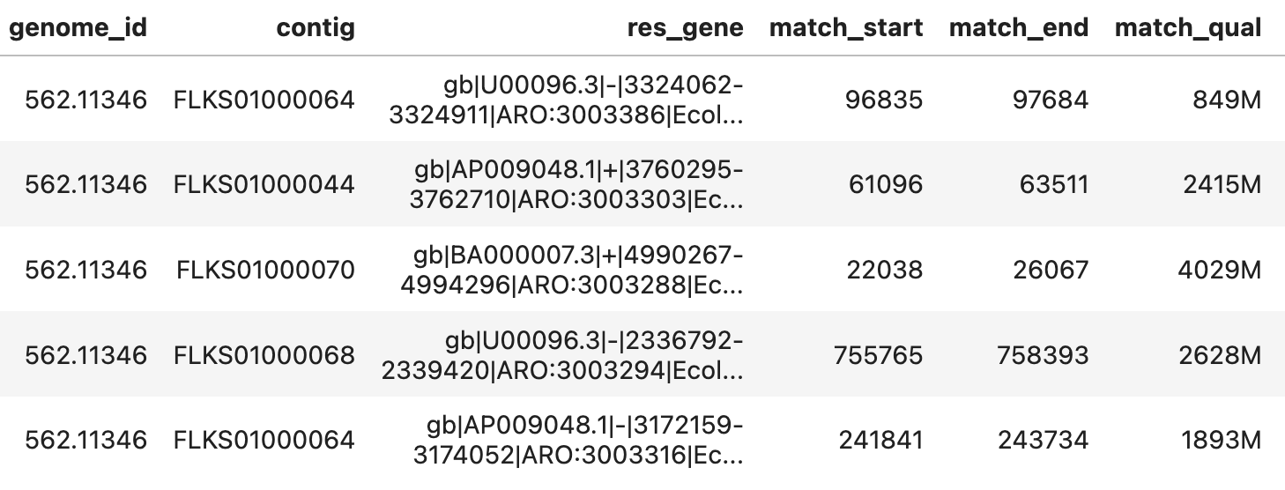
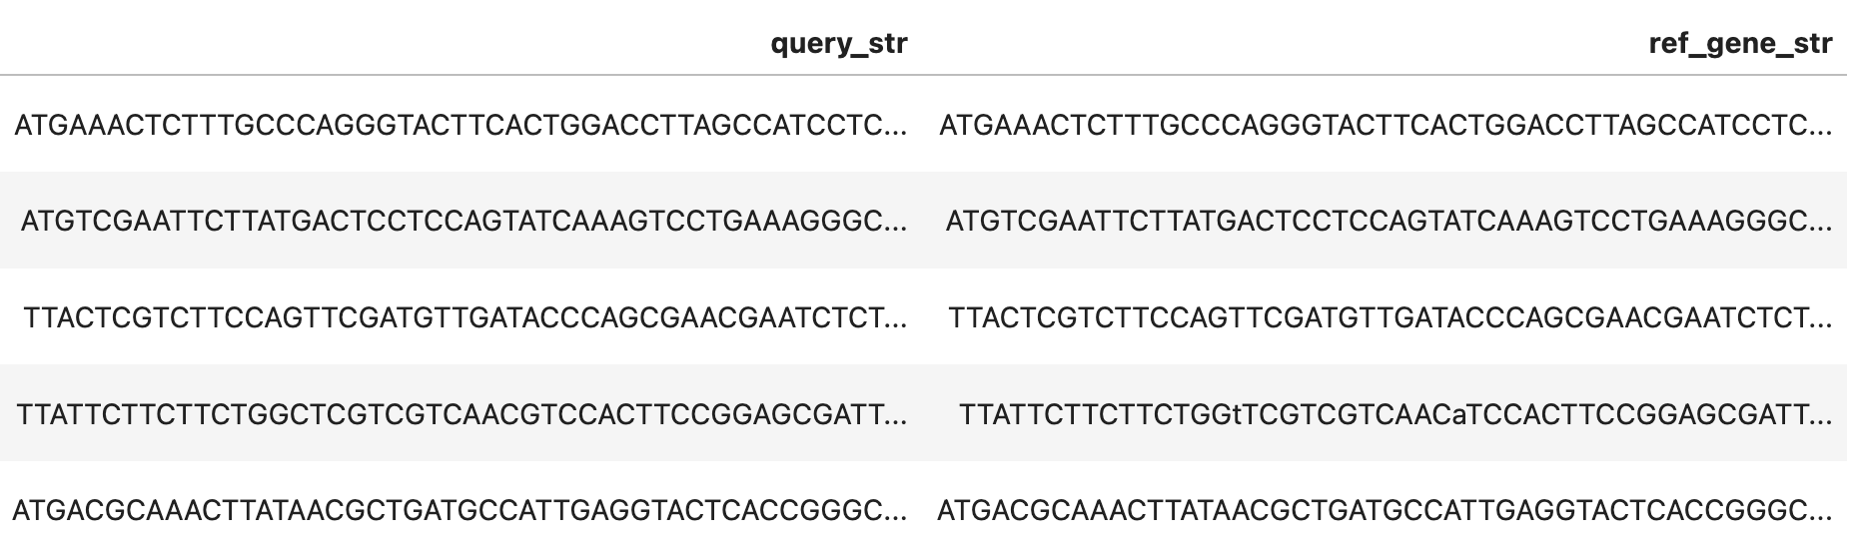
Gene Presence Absence
Input Data - Gene Alignment
Simplest and most approachable feature
Minimal processing required
Saw an example of this last week
Tabular approach
Standardize the data into a fixed shape
Need to have a consistent size per sample
Binary
Outcomes will be present vs absent for every possible gene

Slide 16
Gene Presence Absence
Presence/Absence Feature Matrix
Format
Reshape to a clean binary matrix
Predicting AMR from genes directly
Loss of a lot of information (sequences, counts)
Correlations
Genes can be very similar
Some genes can appear in all samples
Clustering
Naive subsetting (throw away genes)
Clustering can be used to group genes hierarchically
 | Gene A | Gene B | Gene C | Gene D
Sample A | 1 | 1 | 1 | 0
Sample B | 0 | 1 | 0 | 1
Sample C | 1 | 0 | 1 | 0
Sample D | 0 | 1 | 0 | 0
Sample E | 1 | 0 | 1 | 1
…
…
Identical Presence Absence

Slide 17
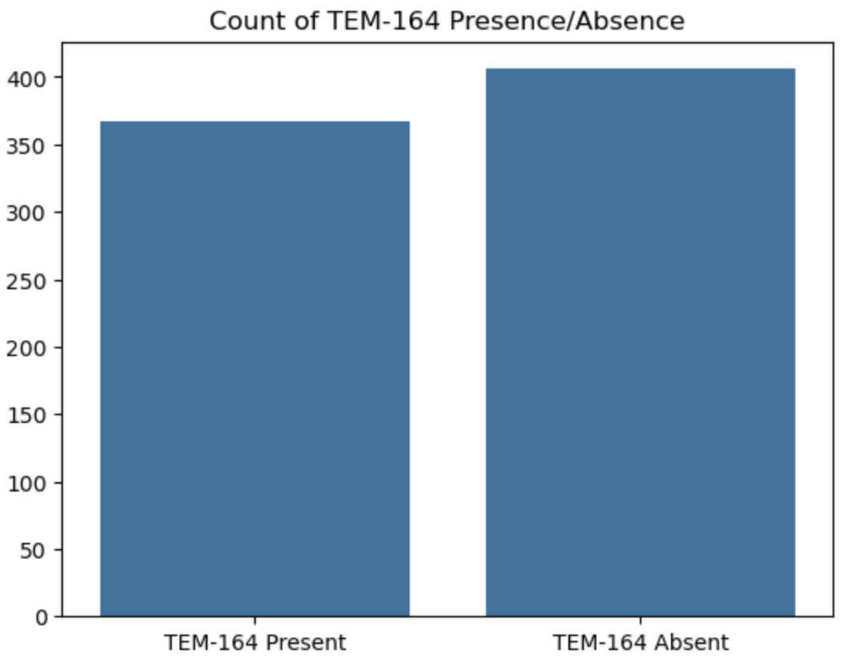
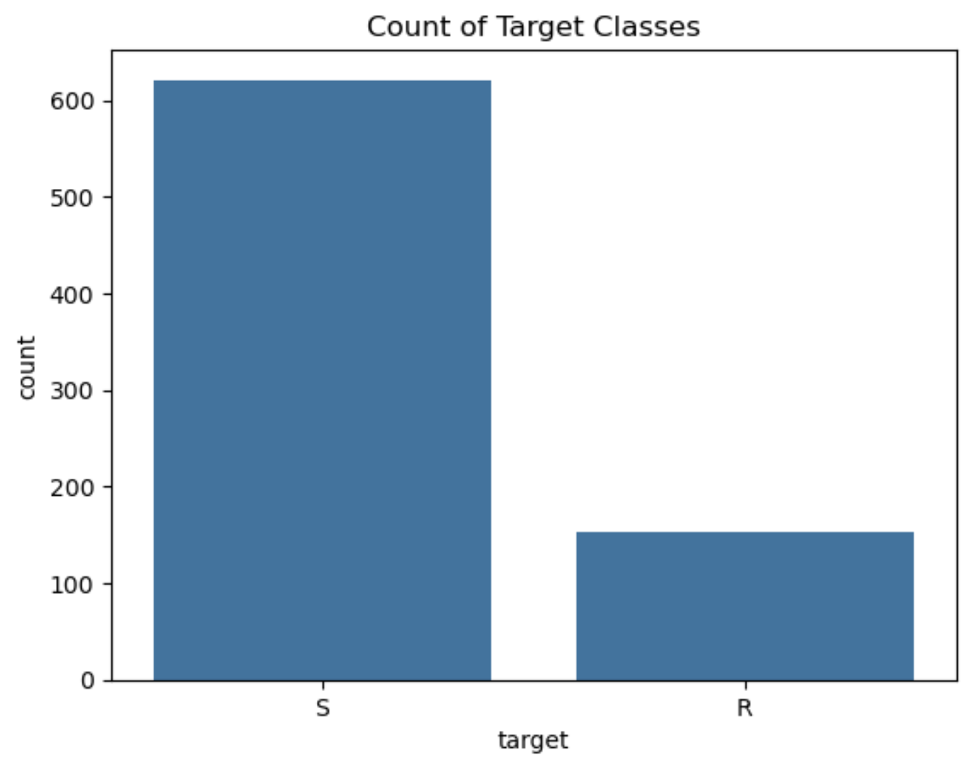
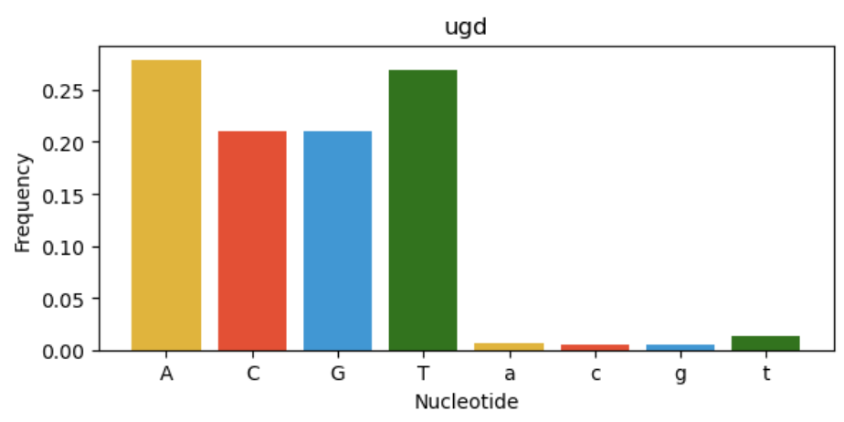
Gene Presence Absence
Why might Gene presence absence not always work?
Weak correlations
Genes can be always present (mutations matter)
Losing information
Query vs Ref Gene String
Raw data has both query & reference
Query = CARD sequencing
Reference = Sample genomes
Lower case = difference in nucleotides
Can we capture these sequence differences?

Slide 18
Kmers
Kmers is one of the most common approaches for featurizing genomic data
Core concepts:
K = Fixed length representation (parameter)
Wish to capture the nucleotide information
Convert from arbitrary sequences to a fixed shape representation
High K = huge feature space, high chance of uniqueness
Low K = small feature space, high chance of repetition within genomes
K is a parameter
2-mers:
16 unique combinations
5-mers:
1,024 unique combinations
10-mers
1,048,576 unique combinations
AA AC AT AG CA CC CT CG
TA TC TT TG GA GC GT GG
AAAAA AAAAC AAAAT AAAAG
AAACA AAACC AAACT AAACG
AAAAAAAAAA AAAAAAAAAG
AAAAAAAAAC AAAAAAAAAT

Slide 19
Kmers
How to generate Kmers?
Want unique occurrences of each kmer
High K’s = millions/billions of sequences
Sliding window approach
Scan the whole sequence one step at a time
Keep track of counts
Using 5-mers:
CGTATAACTGAGGAACAGCGGTTAAC
Slide a window of size K across the genome

Slide 20
Kmers
How to generate Kmers?
Want unique occurrences of each kmer
High K’s = millions/billions of sequences
Sliding window approach
Scan the whole sequence one step at a time
Keep track of counts
Using 5-mers:
CGTATAACTGAGGAACAGCGGTTAAC
CGTAT = 1
GTATA = 1
Count each occurrence

Slide 21
Kmers
How to generate Kmers?
Want unique occurrences of each kmer
High K’s = millions/billions of sequences
Sliding window approach
Scan the whole sequence one step at a time
Keep track of counts
Using 5-mers:
CGTATAACTGAGGAACAGCGGTTAAC
CGTAT = 1
GTATA = 1
TATAA = 1
Count each occurrence

Slide 22
Kmers
How to generate Kmers?
Want unique occurrences of each kmer
High K’s = millions/billions of sequences
Sliding window approach
Scan the whole sequence one step at a time
Keep track of counts
Using 5-mers:
CGTATAACTGAGGAACAGCGGTTAAC
CGTAT = 1
GTATA = 1
TATAA = 1
ATAAC = 1
Count each occurrence

Slide 23
Kmers
Kmer Count Matrix
 | CGTAT | GTATA | TATAA | ATAAC
Sample A | 10 | 1 | 34 | 0
Sample B | 0 | 3 | 30 | 0
Sample C | 3 | 1 | 54 | 0
Sample D | 8 | 2 | 21 | 0
Sample E | 0 | 1 | 24 | 1
Using 5-mers:
CGTATAACTGAGGAACAGCGGTTAAC
…
CGTAT = 1
GTATA = 1
TATAA = 1
ATAAC = 1
Count each occurrence
…
…

Slide 24
Sequences
Sample A
GeneA: GTATCTGAGGAAC
GeneB: GAGGAGATTCGCT
GeneC: TGAAACGTATGCC
Sequences are the most raw format of data
Most difficult to work with
Convolutional/Recurrent Neural Networks
Few proven working examples in literature
Challenges:
Data size (full sequences are millions of characters)
Complexity vs Training data
Working with Sequence models is an optional extension
Computationally complex
Possible option for final project
See paper for reference: https://www.ncbi.nlm.nih.gov/pmc/articles/PMC8722762/
Sample B
GeneA: GTATCTGAGGAAC
GeneC: TGAAACGTATGCC
GeneD: GAGGAGATTCGCT

Slide 25
Sequences
Sample A
GeneA: GTATC
GeneB: GAGGA
GeneC: TGAA
Simple sequence featurization scheme:
Randomly concatenate genes
Find all genes and stack together
Require a consistent length
Truncate or Pad ends
One hot encode to numeric
GTATC-GAGGA-TGAA
Sample B
GeneA: GTATC
GeneC: TGAAA
GeneD: TATGCA
GTATC-TGAAA-TATGCA

Slide 26
Sequences
A=1 C=2 G=3 T=4 Pad=0
Sample A
GTATCGAGGATGAA
Simple sequence featurization scheme:
Randomly concatenate genes
Find all genes and stack together
Require a consistent length
Truncate or Pad ends
One hot encode to numeric
3414231331431100
Sample B
GTATCTGAAATATGCA
3414243111414321

Slide 27
Baseline Models

Slide 28
What is a Baseline Model?
Predictions
Targets
2 Classes
63% accuracy
In any ML task: set ourselves a target to beat
Understand how well we’re performing
Performance statistics out of context can be misleading
Is 80% accuracy good? What about 20% accuracy?
If we have two targets? If we have 50 targets?
Baselines should be interpretable
7 Classes
25% accuracy

Slide 29
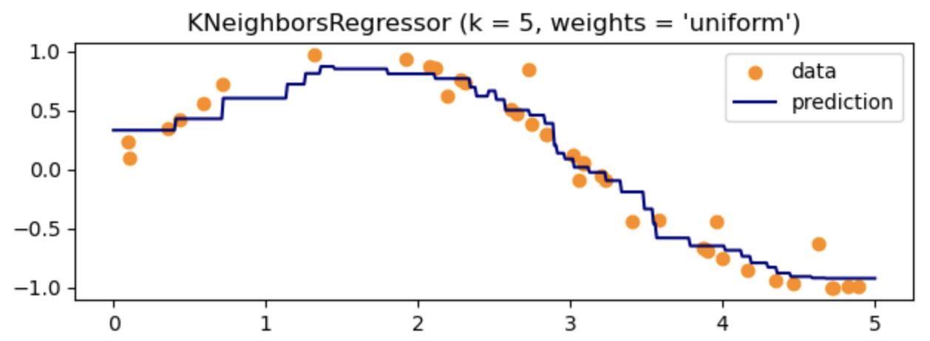
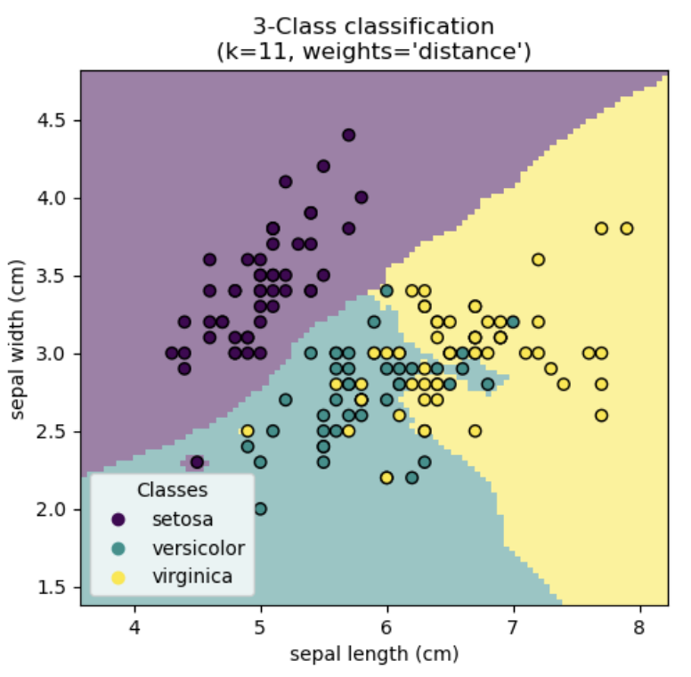
Common Baselines
Examples: KNN Regression & Classification
Completely Random
Nonsense worst case model
Useful to flag if data processing has failed
E.g. accidentally mixed up targets
Predict the majority class
True “baseline”
Simplest way to get maximum performance
KNN (K-nearest neighbor)
Doesn’t require training
Directly learn based on neighbors
Simple and interpretable
[1]
[2]

Slide 30
Workshop 4
Featurization & Baseline Modeling

Slide 31
References
[1]:https://scikit-learn.org/stable/auto_examples/neighbors/plot_regression.html#sphx-glr-auto-examples-neighbors-plot-regression-py
[2]:https://scikit-learn.org/stable/auto_examples/neighbors/plot_classification.html#sphx-glr-auto-examples-neighbors-plot-classification-py

